Slide 1
AstroTrace Analytics
Name: Kiran Kumar.L
Date:17-12-2023

Slide 2
INTRODUCTION

Slide 3
Welcome to a data-driven exploration of the environmental impact of food production, presented as part of the radicalx hackathon. I am kiran kumar, and in this project, I explore the details surrounding the carbon footprint of food production, employing data analysis and web scraping techniques to uncover insights that contribute to environmental awareness.

Slide 4
OBJECTIVE

Slide 5
The primary goal of this project is to shed light on the carbon footprint associated with various aspects of food production. By leveraging the power of data analysis using the pandas library and visualizations with matplotlib, I aim to identify key contributors to environmental impact.

Slide 6
METHODOLOGY

Slide 7
DATA COLLECTION AND PROCESSING

Slide 8
A comprehensive dataset, sourced from a CSV file, forms the foundation of this analysis. This dataset includes essential variables such as date, type of food production, and corresponding carbon footprint values. Utilizing the pandas library, I meticulously processed the dataset to extract meaningful insights.

Slide 9
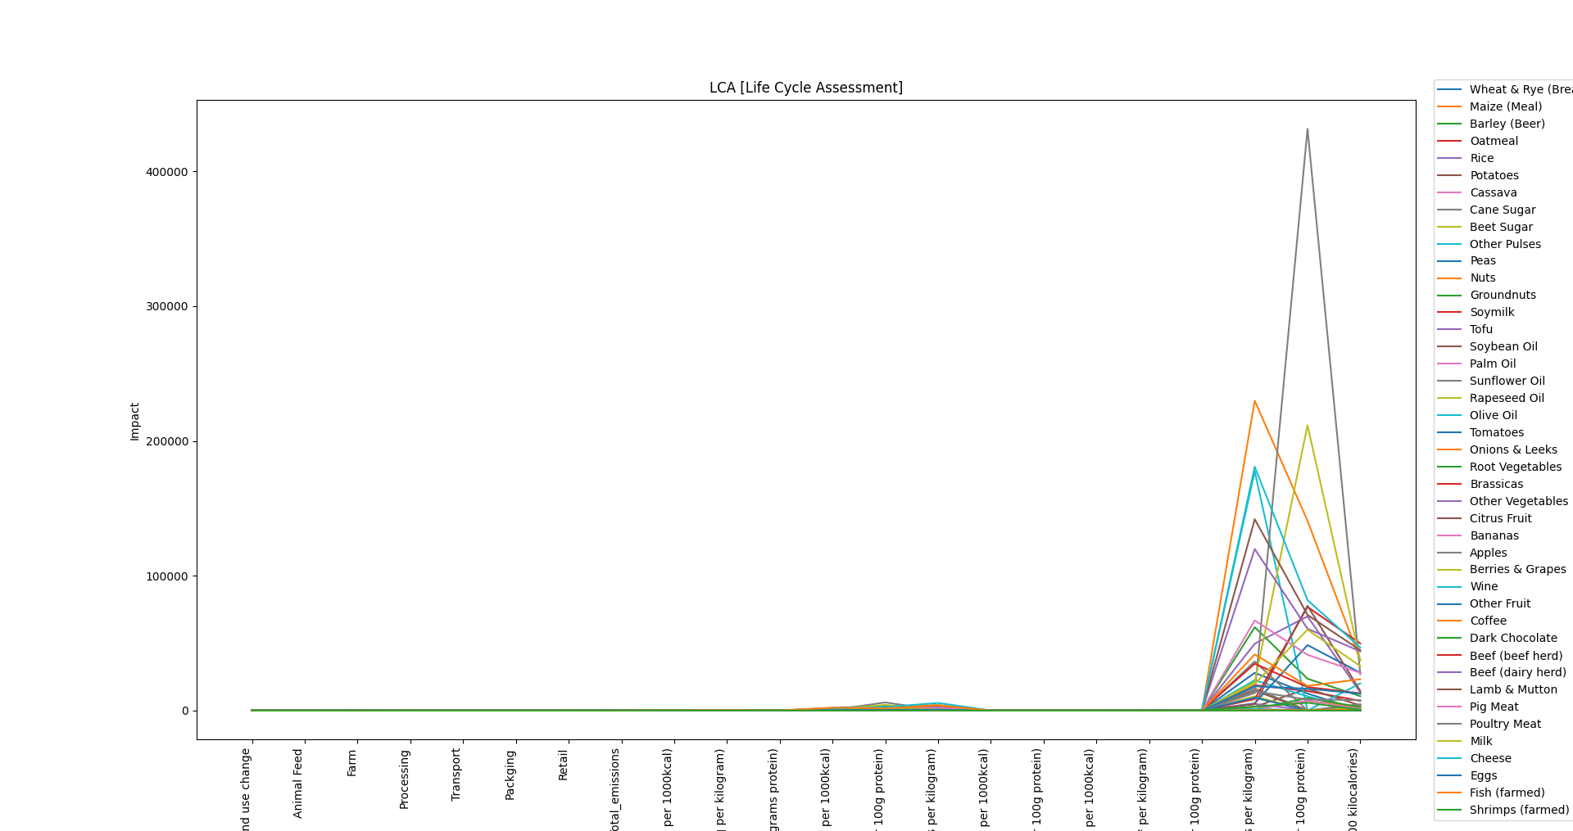
LCA [Life Cycle Assessment ]

Slide 10
IDENTIFYING HIGH-IMPACT FACTORS

Slide 11
Through data analysis, I pinpointed the specific types of food production that contribute significantly to environmental impact. Visualizations, such as bar charts and graph charts, were employed to illustrate these findings.

Slide 12
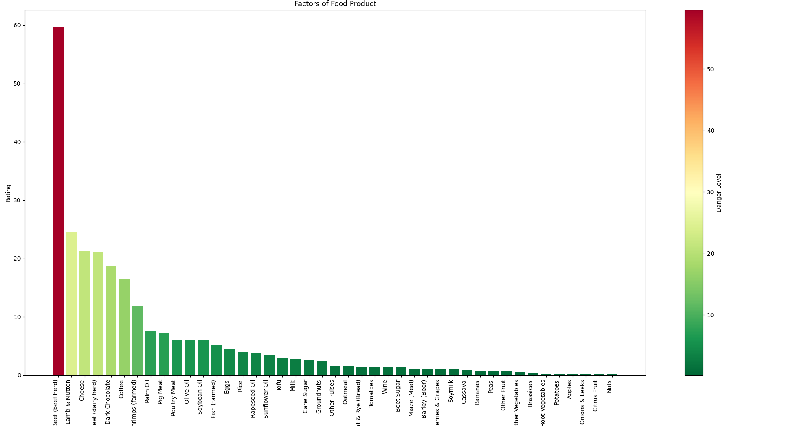
Food Emission Impact

Slide 13
WEB SCRAPING

Slide 14
To enhance the depth of analysis, I incorporated web scraping techniques using the Googlesearch library. After identifying the food productions with the highest carbon footprint, the tool dynamically searched for effective solutions for each high-impact category. The outcome was a curated CSV file containing the top 5 web links offering solutions to mitigate the environmental impact of specific high-emission food productions."

Slide 15
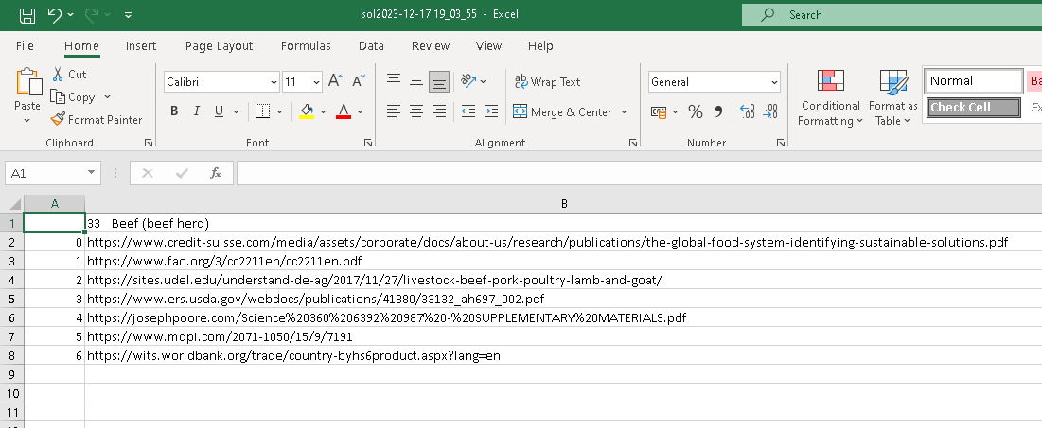
Generated Report

Slide 16
CONCLUSION

Slide 17
Understanding the environmental impact of food production is crucial in today's context of sustainability. By presenting clear insights, this project aims to raise awareness about the importance of making informed choices in food consumption and production practices to mitigate our ecological footprint.

